Slide 1

Maker Space
Kyler Kershaw
Daniel Bigler
Marcus Mitchell
Jessica Prater

Slide 2
Who we are
Kyler
Daniel
Jessica
Marcus

Slide 3
What does the program do?
Inventory management
Scheduling and booking
Logins
Newsletters
Admin access.

Slide 4
Who's the program for?
Creatives in the STEM fields
Hobbyist
Professionals
Students

Slide 5
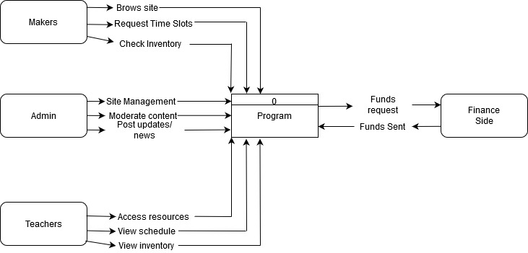
Context diagram

Slide 6
Wireframe
The wire is going to a blue print of the website and how it malfunctions through different programs
Flask is being used as a behind the scenes source in order for everything to work correctly

Slide 7
What is Makerspace
Social collaborative space for people to learn and shape skills together
Contains classes to further education and skills
Contains elements from all types of hobby and project creation

Slide 8
Possible future additions to code
Scheduling spaces and materials
Subscriptions so you don’t have to pay each time you walk in
View available and scheduled spaces and materials, can also be used when restocking

Slide 9
Front End
Responsible for designing a making the website look presentable
Having login forms and making it available for customers to sign up and make accounts

Slide 10
What we’re using
Python
Flask
SQLite
Bootstrap/ HTML

Slide 11
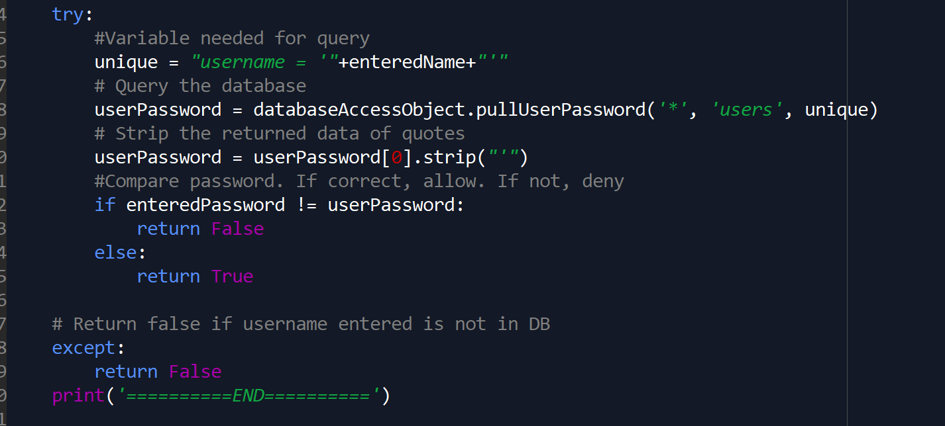
Python
Used for logic and processing
Pass information back and forth

Slide 12
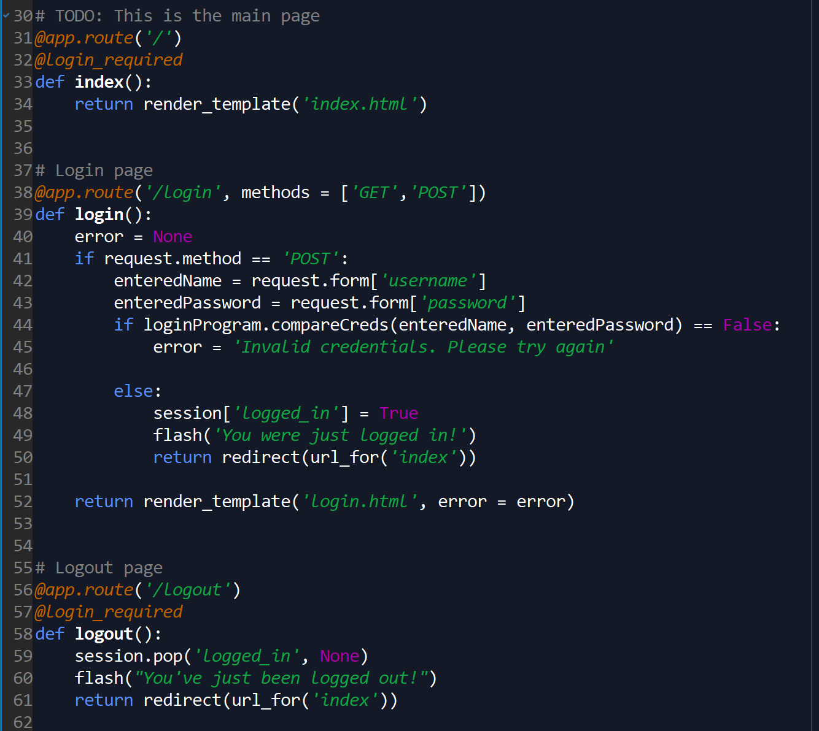
Flask
Used to patch Python and HTML
Handles routing users through the site
Manages login status and session information

Slide 13
SQLite
Database structure
Queries sent by Python to manage/work the db
Stores and returns data based on program needs

Slide 14
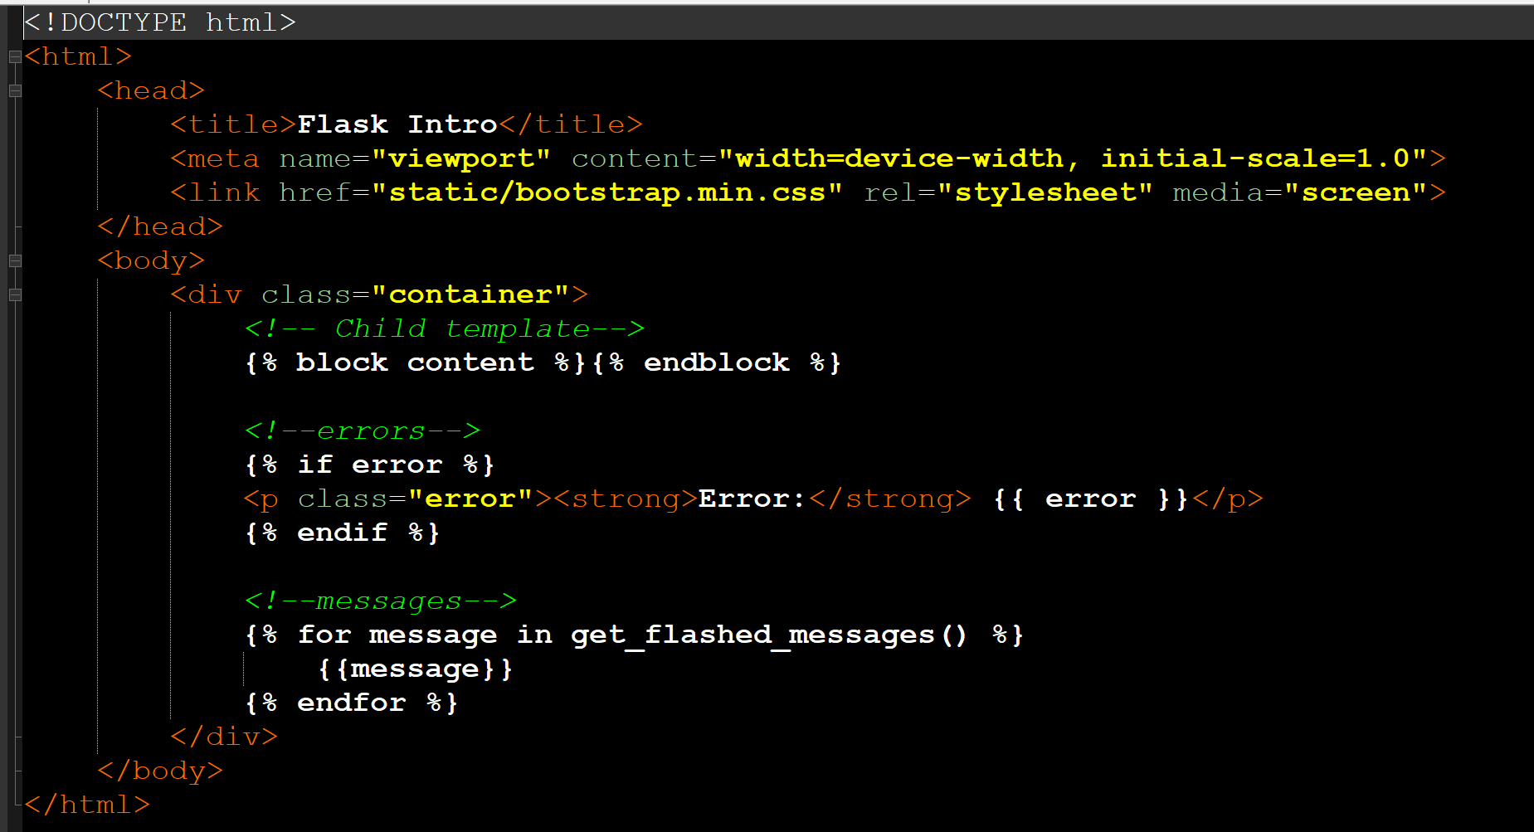
Bootstrap/HTML
HTML is the website displaying in browser
Bootstrap to arrange

Slide 15
Q&A
Questions?

